Slide 1






Lunenburg Electrical Utility Council Report Presentation
Date: October 28, 2025

Slide 2
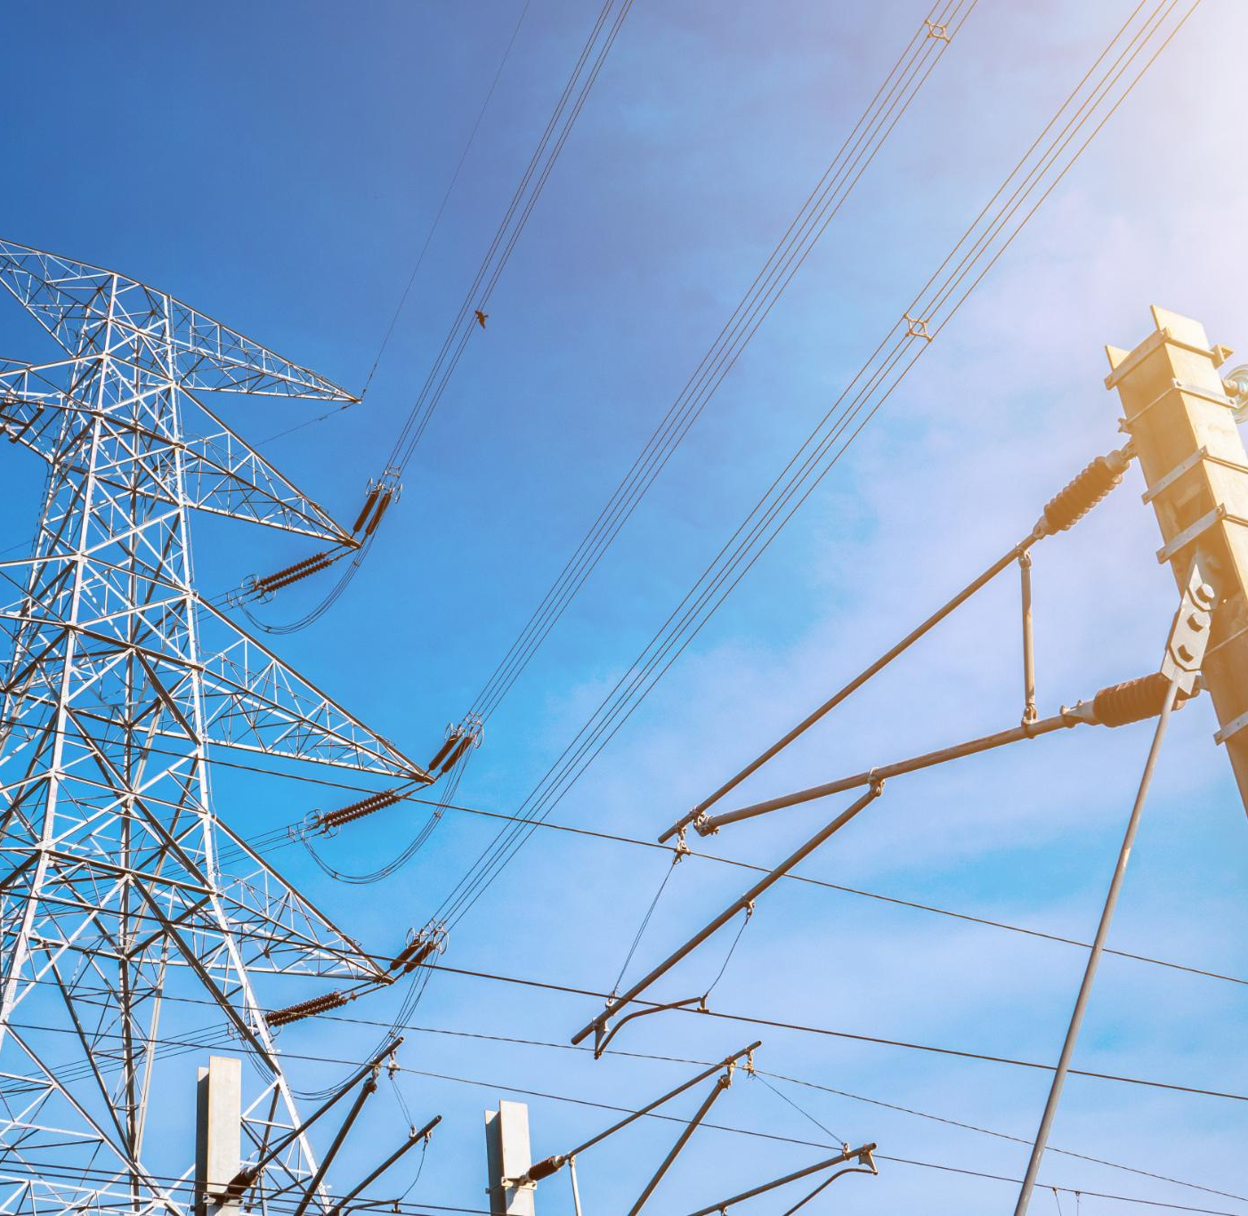
Historical Context & Service Agreement
Utility Review Timeline
The Lunenburg Electrical Utility has been reviewed since 2022, with a major evaluation in April 2023.
Service Contract Details
LEU operates under a service contract with NSP signed in 2018, extended three times, expiring in 2026.
Future Decision Urgency
Council must decide on renegotiation or ownership by November 2025 to guide LEU's future.

Slide 3

MMEUA Alliance Participation
The Maritime Municipal Electric Utility Alliance
"The Maritime Municipal Electric Utility Alliance is dedicated to advancing the clean energy transition through collaboration, innovation, and shared expertise. By working together, we strengthen grid reliability, enhance sustainability, and empower our communities for the future."

Slide 4
MMEUA Cont.
Alliance Benefits
The Maritime Municipal Electrical Utility Alliance promotes clean energy and grid modernization for member municipalities.
Cost and Participation
Participation in the alliance is free unless the Town opts into funded projects, encouraging risk-free collaboration.
Strategic Decision Impact
Retaining the utility maintains alliance benefits; selling terminates participation without penalties, affecting future projects.
Importance of Partnerships
Strategic partnerships enhance sustainability goals, service delivery, and emphasize municipal ownership value.

Slide 5

Opportunity to Sell the Utility
Utility Condition and Market Value
Current utility condition and needed upgrades may lower market value, influencing sale decisions.
Transfer of Responsibility
Sale transfers improvement and service duties to the new owner, removing the Town’s control over rates.
Impact on Service and Customer Satisfaction
Loss of municipal control may impact service quality and customer satisfaction levels.
Legal and Financial Considerations
Legal consultation is necessary; sale offers financial relief but sacrifices strategic control.
Lunenburg Electrical Utility

Slide 6

Opportunity to Retain the Utility
Investment and Planning
Retaining the utility requires council approval of a five-year Capital Plan and initiating new service agreements to ensure continued operations.
Preventative Maintenance
Emphasis on preventative maintenance, like tree clearing and grid resilience, improves reliability and aligns with climate adaptation strategies.
Long-term Strategic Benefits
Retention supports community service quality, infrastructure sustainability, and may increase asset value for potential future sale.

Slide 7
Council Priorities & Municipal Strategy
Strategic Plan Priorities
The Council’s Strategic Plan focuses on sustainable infrastructure, building community trust, and ensuring effective communication. MPS, CCP.
Infrastructure Optimization
The Municipal Plan Strategy emphasizes maintaining and optimizing existing infrastructure to balance costs and benefits effectively.
Renewable Energy Support
Land Use By-Law encourages electric vehicle charging stations and solar panel systems to promote renewable energy integration.
Grid Resiliency and Innovation
The Comprehensive Community Plan highlights grid resiliency, smart grid adoption, and renewable energy initiatives for sustainable development.
Council Priorities:
1. Electrical Utility
2. MPS, LUB, Heritage By-Law, CCP
3. HR Procedures
4. Community Trust
5. Internal and External Communications

Slide 8


Financial Forecast & Rate Planning
Projected Deficits
LEU anticipates deficits of $133,500 in 2025/26 and $282,000 in 2026/27 due to high power costs and financial obligations. 80% of cost = purchasing power
Cost Management Strategies
Staff recommend pursuing grants, lower-cost service contracts, and reviewing allocations to control expenditures effectively.
Financial Sustainability
The financial strategy focuses on sustainability, cost-effectiveness, and proactive planning for long-term utility viability.

Slide 9
Capital Plan Overview (2025–2030)
Project | Timeline | Cost
Wheelhouse/HVH Expansion | 2025/2026 | $2.37M
Green Street Circuit Upgrade | 2026/2027 | $1.4M
Substation Prep | 2026/2027 | $1M
New Substation | 2027/2028 | $2.6M + 500K contingency
Feeder Upgrades | 2027-2029 | $2.7M
AIM Meter Conversion | 2026-2029 | $400K - $600K
Capital Plan Overview
The five-year plan budgets $18M–$20M for modernizing and expanding grid infrastructure to support growth and resilience.
Key Infrastructure Projects
Projects include Wheelhouse/HVH Expansion, Green Street Circuit Upgrade, substations, feeder upgrades, and AIM meter conversion.
Financial Projections
Debt ratios are projected between 5.8% and 11.7% over five years, reflecting strategic infrastructure investment and funding assumptions.
Strategic Goals
The plan aims to improve service reliability, meet future demand, and support climate adaptation through infrastructure upgrades.

Slide 10
Projected Debt Ratios
Year | Debt Ratio
2026/2027 | 5.8%
2027/2028 | 6.8%
2028/2029 | 10.6%
2029/2030 | 11.7%

Slide 11
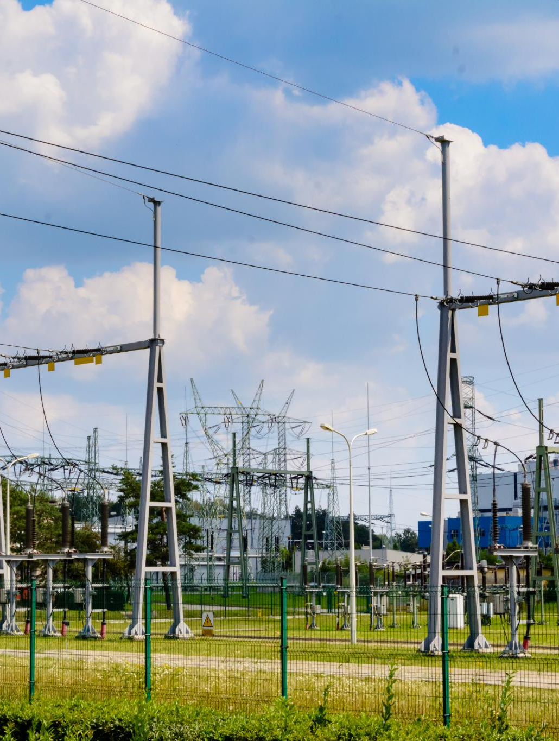
Council Recommendation
Continued Utility Ownership
Council is recommended to maintain ownership and control over the Lunenburg Electrical Utility to ensure operational oversight.
Capital Plan Approval
Approval of the five-year Capital Plan is vital to secure funding and drive modernization and resilience of utility infrastructure.
Strategic Infrastructure Management
Recommendations support a proactive approach aligned with sustainability and enhancing community services through infrastructure investment.

Slide 12

Alternative Options
Approve Utility Sale
Selling the utility transfers ownership and relieves operational and climate risks, but loses control over service quality and rates.
Table the Decision
Delaying the decision maintains current operations but may postpone important strategic actions affecting the community.
Implications Overview
Each option impacts financial outcomes, community welfare, and long-term utility governance, requiring careful consideration.

Slide 13
Summary & Next Steps
• Council decision due November 2025 and/or approve Capital Plan
• If retain – start NSPI negotiations for Service Agreement
• If sell – begin legal and valuation process
• Continue aligning with climate and infrastructure goals

